Slide 1

Secondary data analysis in HEAT Center
Meeting with Professor Paul Ruff
29 October 2023

Slide 2
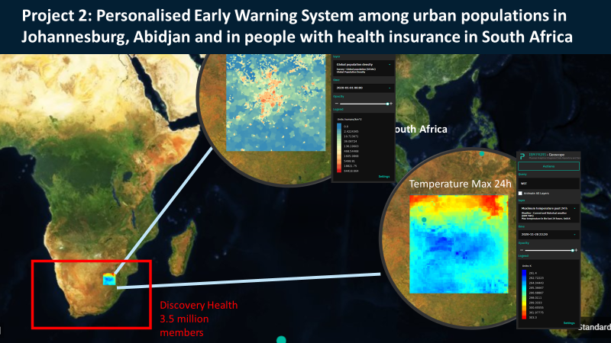
DS-I Africa slide as background
Total funds..
Reanalysis

Slide 4
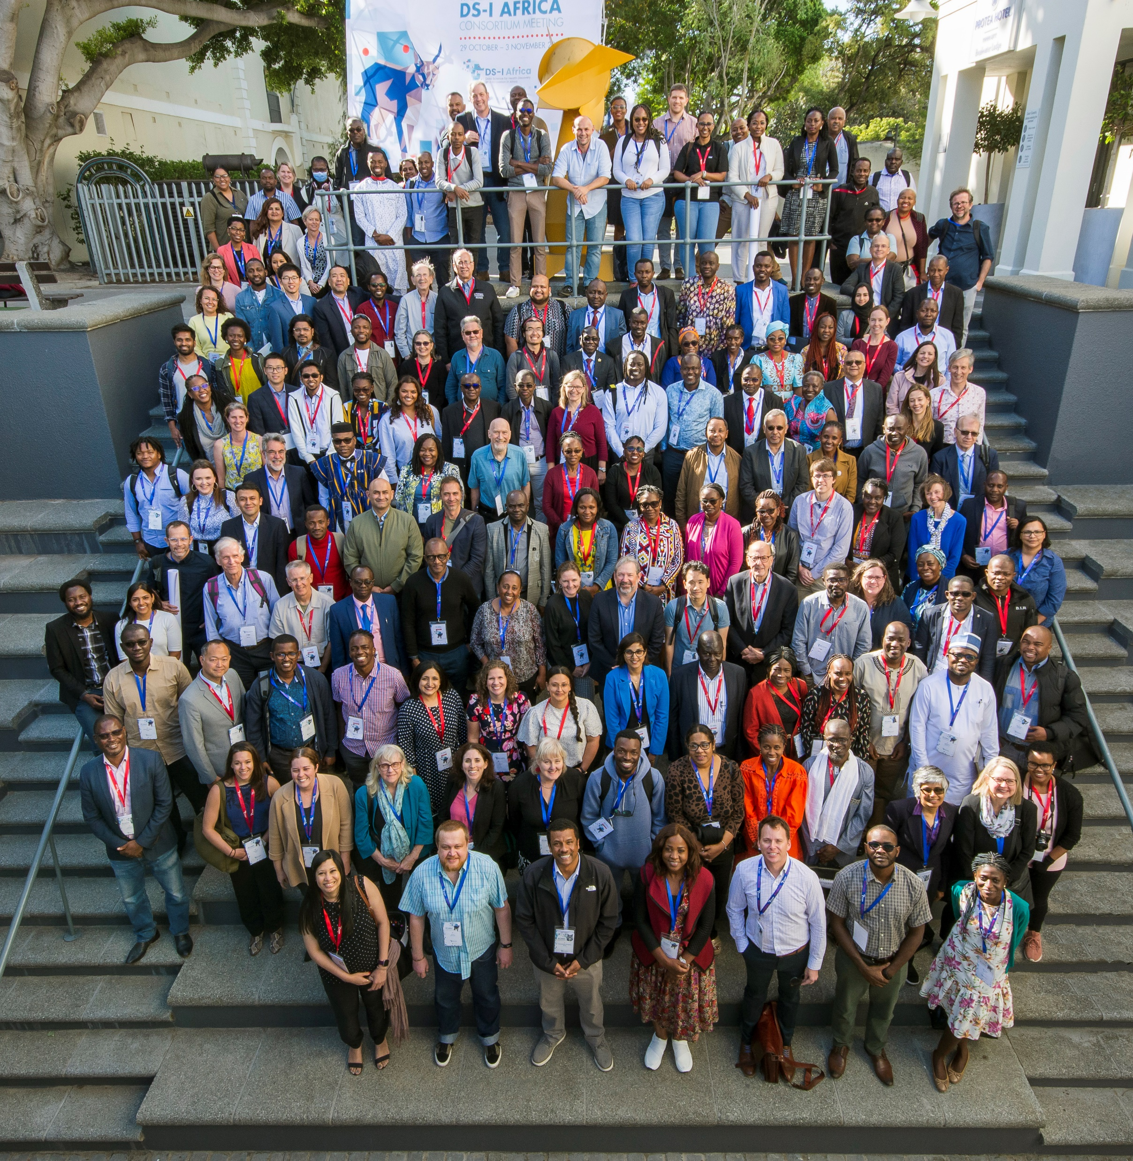


Notes:
Note H3Africa and MADIVA is also a U54

Slide 6

Notes:
4 levels: feasible to get data, to get quality data and to analyse and then does that improve health

Slide 7
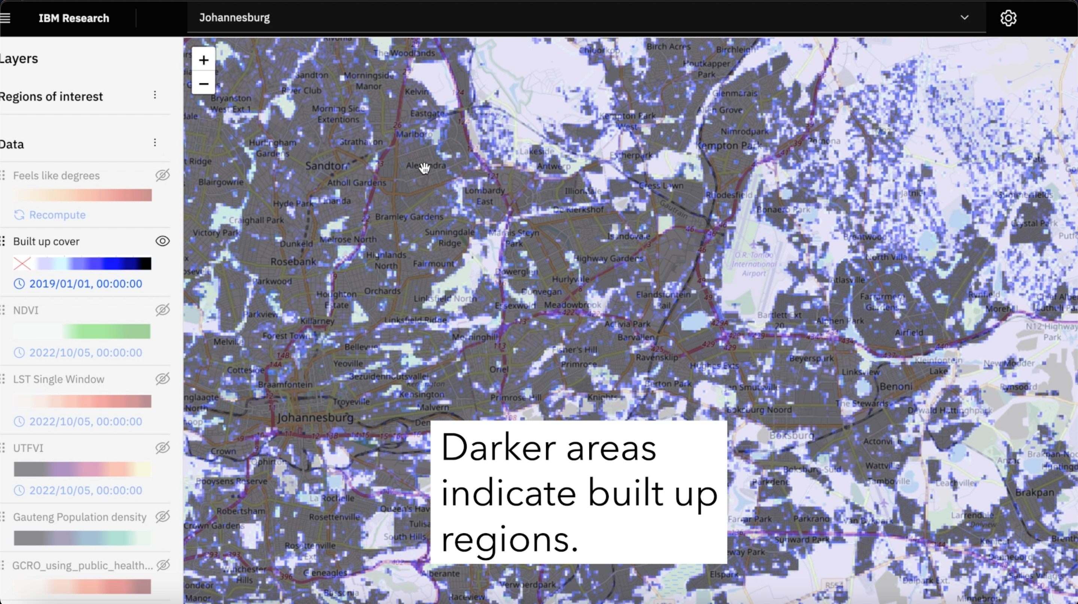
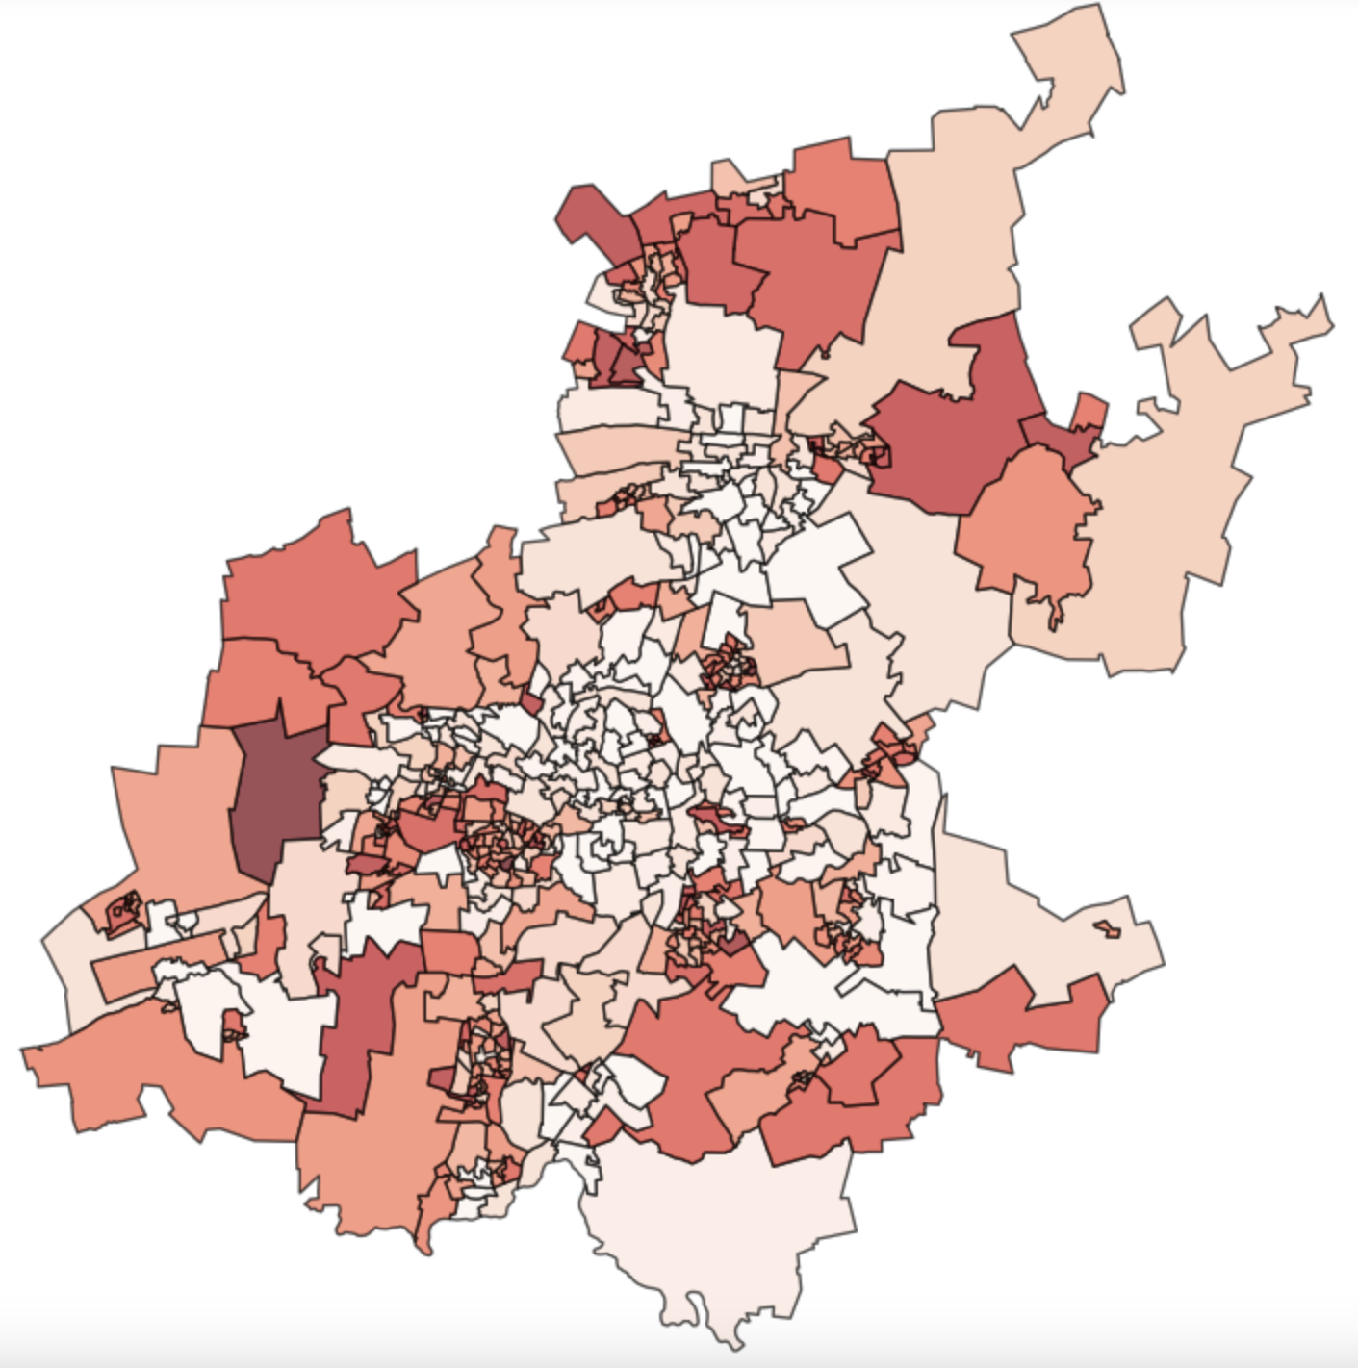
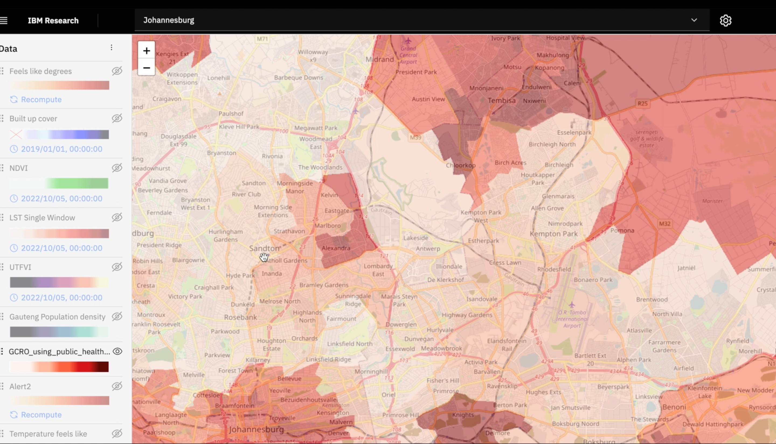
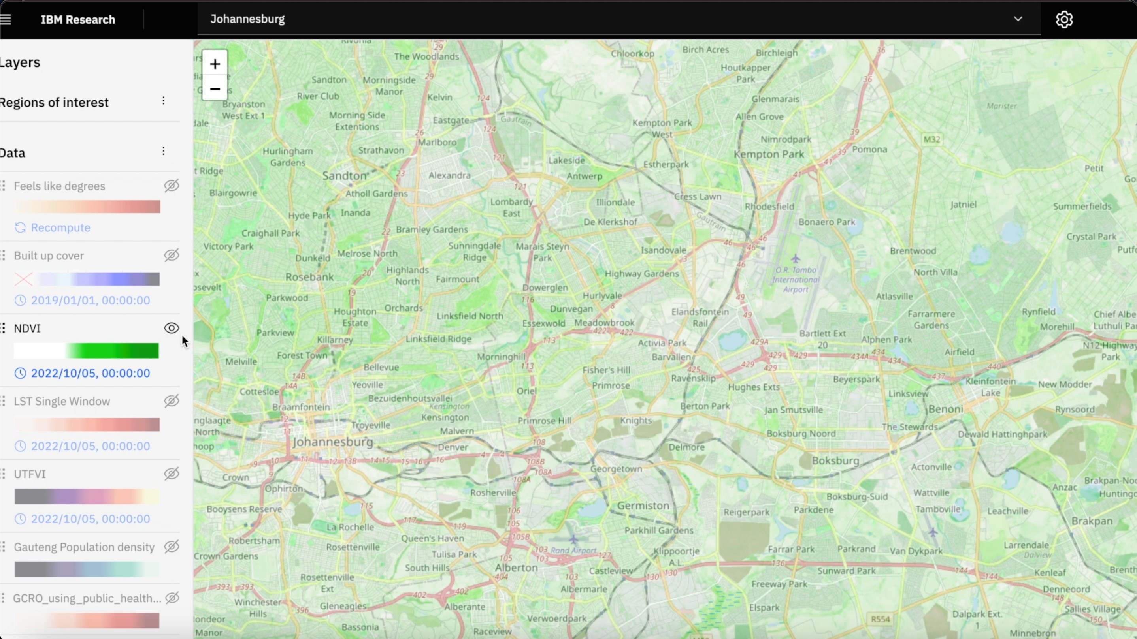
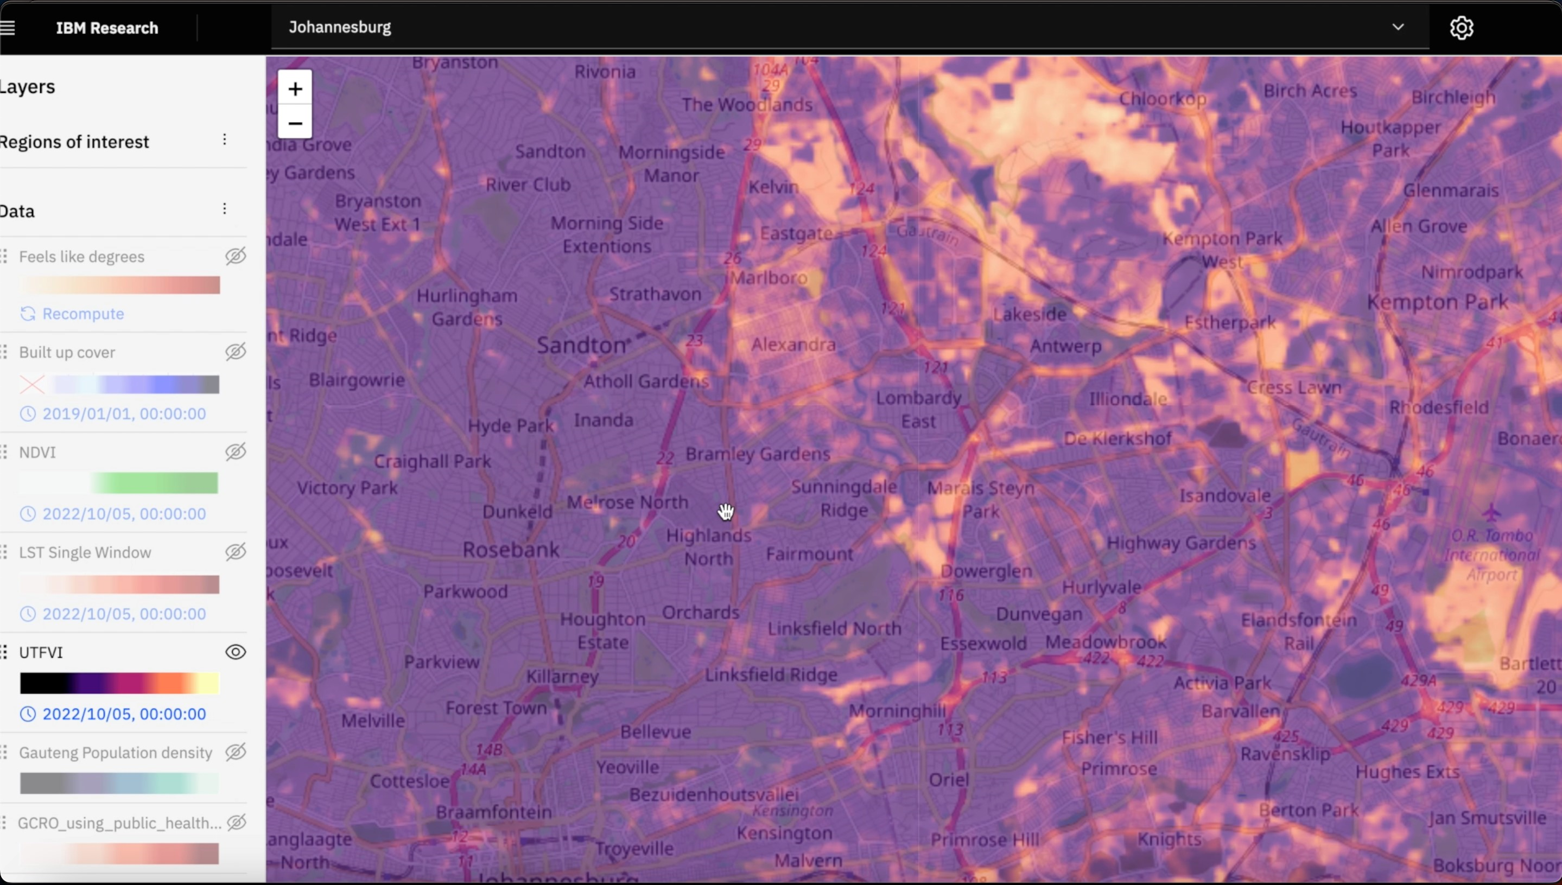
Spatial Vulnerability Mapping
Spatial Vulnerability Mapping
Data Synthesis via Principal Component Analysis: A process to identify primary factors of vulnerability
Vulnerability Layers: Building Structures, Vegetation Coverage, Socio-economic Indicators (GCRO Data), and Climatic Factors like Temperature Extremes.
Heat Vulnerability Map: A Visualization of Spatial Disparities in Risk Exposure

Slide 8
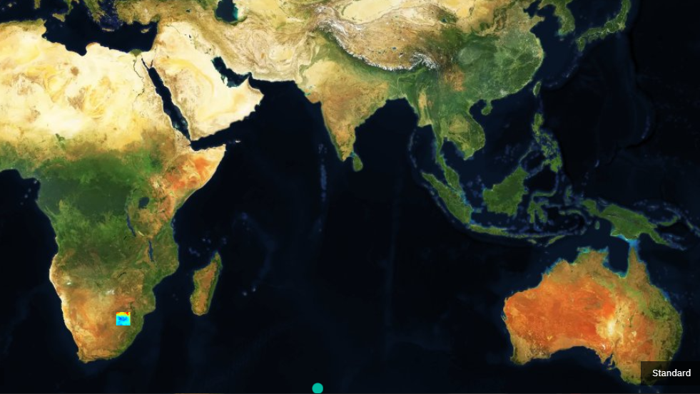
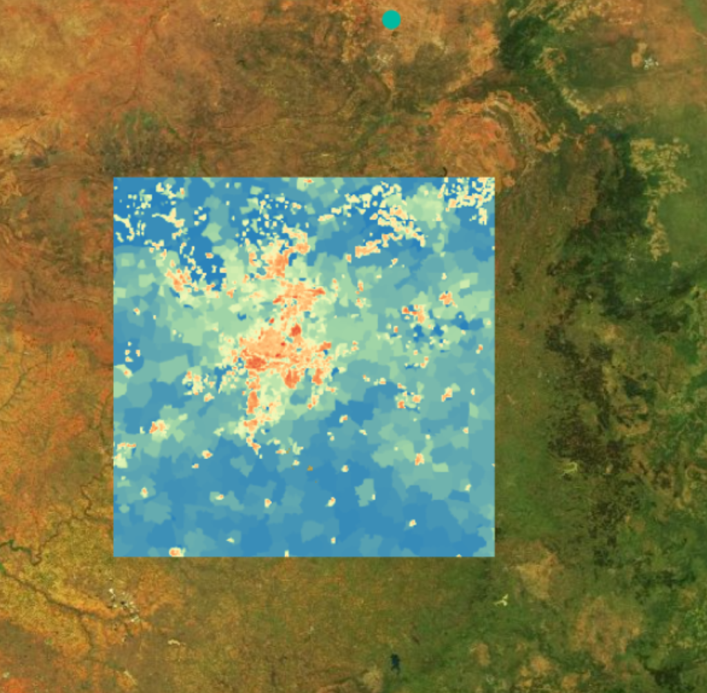
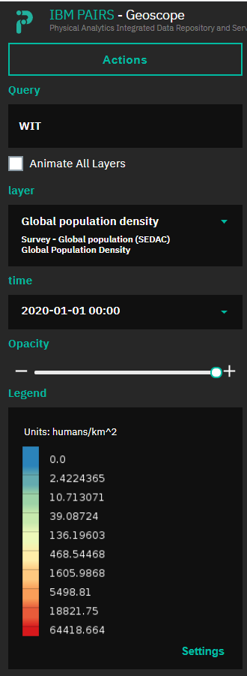
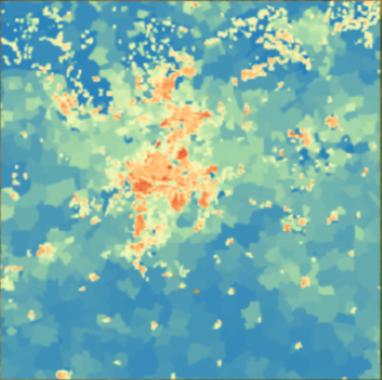
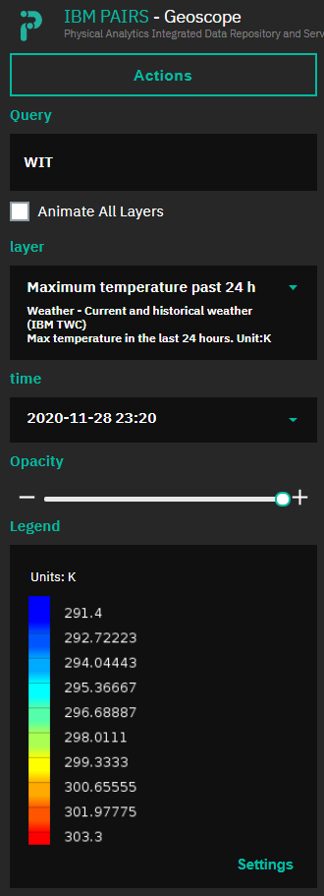
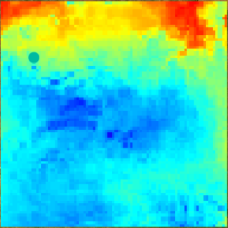
Project 2: Personalised Early Warning System among urban populations in Johannesburg, Abidjan and in people with health insurance in South Africa
Population
Gauteng, South Africa
Temperature Max 24h
Discovery Health 3.5 million members

Slide 9
Overview
Introduction to the HE²AT Center
Partners and funder
Research Projects 1 and 2
Public health importance
Data flows
Data that we have received
Ethical justification for informed consent waiver (documents 1-5)
Legal justification for use of secondary data for research purposes (documents 6-10)
Next steps

Slide 10
HE²AT Center
The HEat and HEalth African Transdisciplinary Center: Developing data science solutions to mitigate the health impacts of climate change in Africa​
10 year project

Slide 11

Overall aims of HE²AT Center
Prepare a data science ecosystem to support analysis of existing environmental, biomedical and other data
Increase knowledge and develop sustainable solutions to address research priorities in climate change and health
Enhance capacity in Africa for data science research
Serve as a continental resource and Center of Excellence

Slide 12

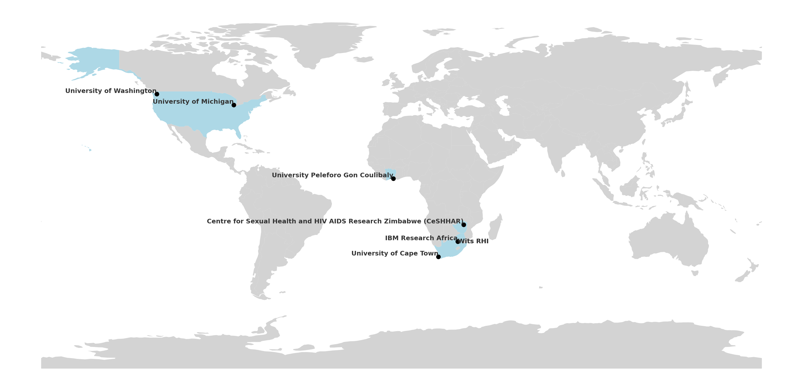
Partners in the H²EAT Center

Slide 14

Research project 2: Urban Heat Islands in Johannesburg and Abidjan
Population
2. Secure collaboration with data providers and finalise legal agreements
Temperature Max 24h
3. Data preparation, harmonisation and analysis
1. Vulnerability mapping (geocoded climate, and other environmental and socio-economic variables)
Johannesburg, South Africa
4. Early Warning System development

Slide 15
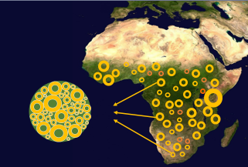
Research project 1: Individual Participant Data analyses
1. Data owner agreement
2. Ethics approval
4. Data management and analysis
3. Legal contract for data transfer

Slide 16


Research Project 1: Heat impacts on maternal and child health
Aim: To use innovative data science approaches to quantify the impacts of heat exposure on maternal and neonatal health in sub-Saharan Africa

Slide 17
Add Ijeoma's flow chart

Slide 18
Research project 2: Urban Heat Islands in Johannesburg and Abidjan
Population
2. Secure collaboration with data providers and finalise legal agreements
Temperature Max 24h
3. Data preparation, harmonisation and analysis
1. Vulnerability mapping (geocoded climate, and other environmental and socio-economic variables)
Johannesburg, South Africa
4. Early Warning System development

Slide 19
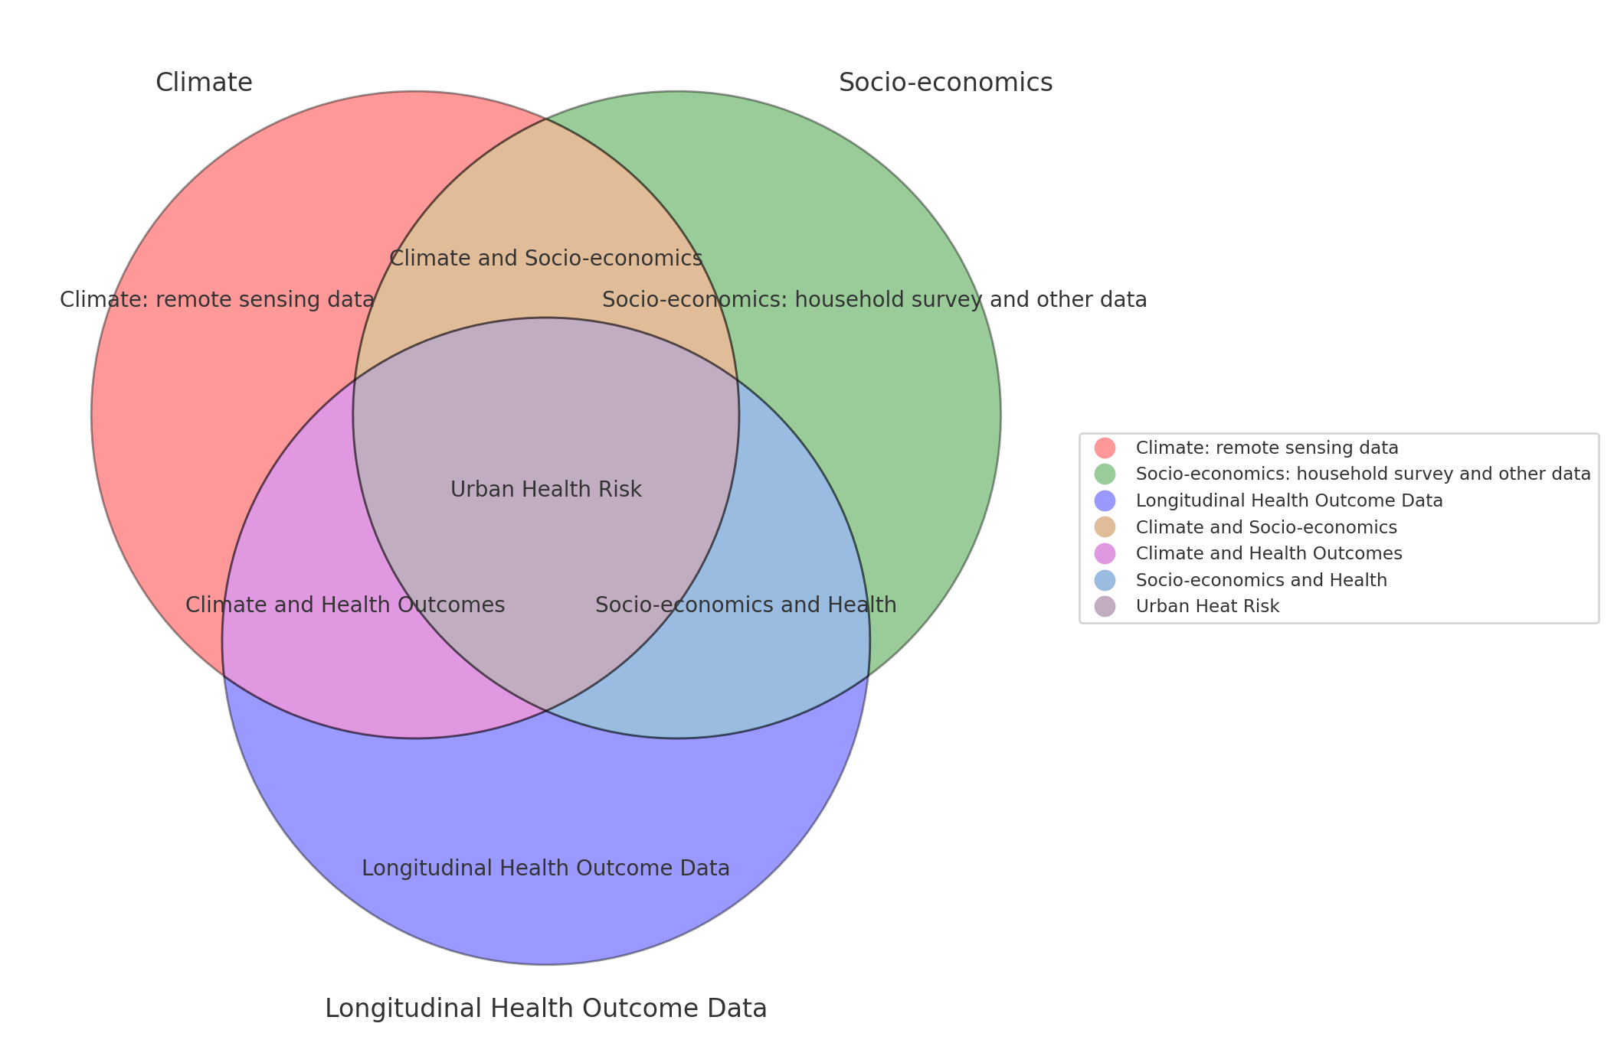
Documenting Urban Health Risks in RP-2: Interplay between climate, socio-economics, and health outcome data
Notes:
Health outcomes…. Climate and health outcomes health outcomes.. …. Longitudinal health outcome data….climate: remote sensing data socio-economics household survey and other data….. Setting the scene . This is how we will create layers within the map in considering climate layers, socio-economics layers and , health status where applicable. Keep it short and sweet as there are lots of slides

Slide 20
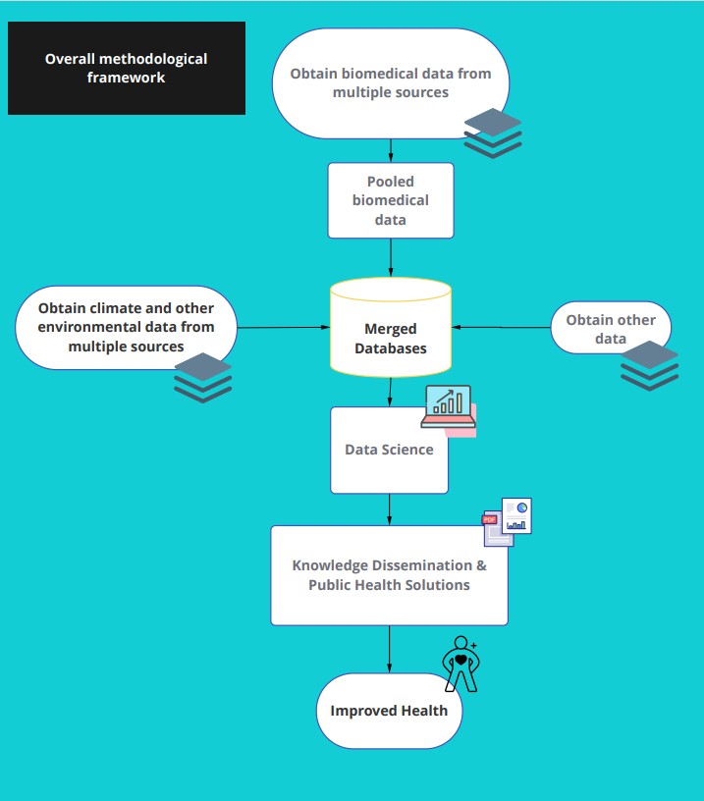

Slide 21
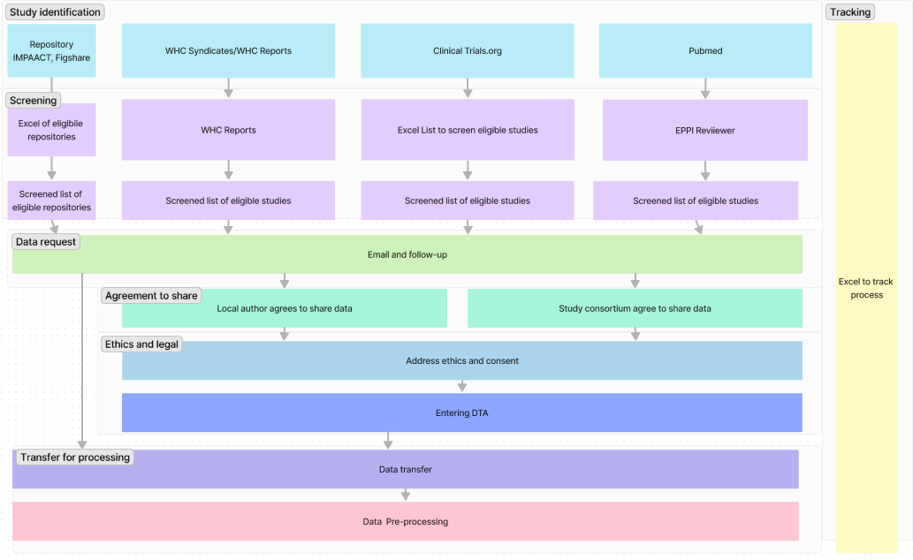
Data acquisition process

Slide 22
Data storage
Secure Data Acquisition and Integration: Utilizing robust protocols for acquiring and integrating environmental, biomedical, and other data types.
Advanced Digital Infrastructure: Leveraging IBM-PAIRS and UCT data center platforms for secure data processing and storage.
Rigorous Data Curation: Employing strict meta-data standards to ensure data interoperability and integrity.
Access Control and Authentication: Implementing strict user authentication and access control policies to prevent unauthorized access.
Data Encryption and Firewalls: Utilizing encryption for data in transit and at rest, and employing firewalls for additional security layers.
Quality Control Mechanisms: Conducting thorough data quality checks to maintain data integrity and reliability.
Backup and Redundancy: Ensuring data is regularly backed up and stored redundantly across multiple secure locations.

Slide 23
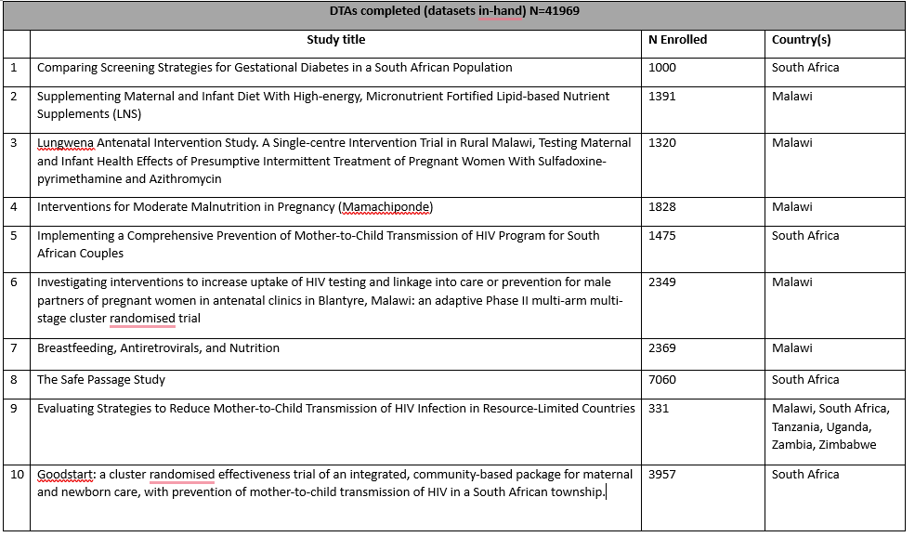
Datasets in hand RP1

Slide 24
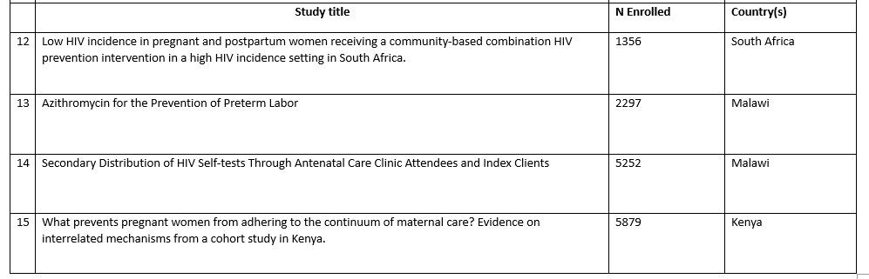
Datasets in hand RP1 continued

Slide 25
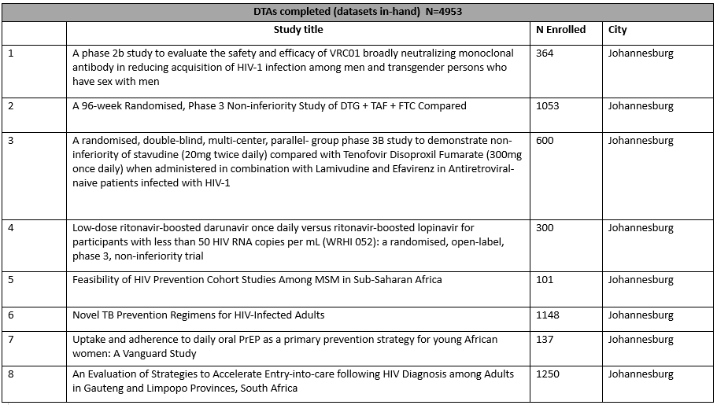
Datasets in hand RP2

Slide 26
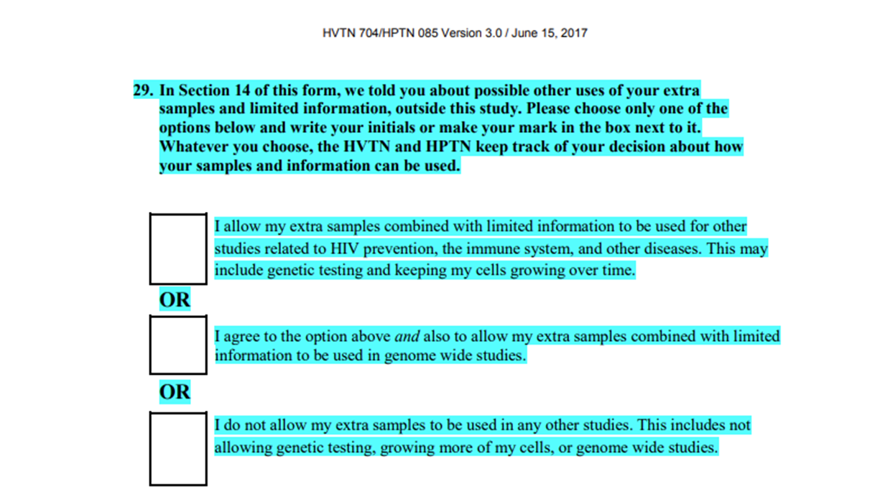
How have we assessed narrow versus broad consent?
Network study - Broad Consent

Slide 27
Ethics waiver justification (ethical)
Meets ethical requirements
SA DoH 2015 Ethics in Health Research Guidelines
US Department of Health and Human Services (HHS) Regulations: 45 CFR 46.116(e)
Declaration of Helsinki Line 32
CIOMS Guideline 4

Slide 28
Ethics waiver justification (ethical)
Research is of public health significance
Impossible, impractical to locate and reconsent study participants and
Impracticable if the requirement for informed consent were to be imposed
Unable to conduct this study without secondary data
Risk to participants is minimal
No additional study procedures
No access to direct identifiers
Safeguarding of data
Remove indirect identifiers once climate data linked
Will not re-identify pts

Slide 29
Ethics waiver justification (legal)
POPIA Section 27 General authorisation concerning special personal information
The prohibition on processing personal information, as referred to in section 26, does not apply if the—
d. processing is for historical, statistical or research purposes to the extent that—
the purpose serves a public interest and the processing is necessary for the purpose concerned; or
it appears to be impossible or would involve a disproportionate effort to ask for consent,4
and sufficient guarantees are provided for to ensure that the processing does not adversely affect the individual privacy of the data subject to a disproportionate extent;
Additional exceptions under sections 6, 14, 15, and 18 for data use for research purposes, or deidentified

Slide 30
Relevant data transfer agreement text
4. The Data Provider will transfer a Limited Data Set to the Data Recipient. A “Limited Data Set” consists of health information that has had all direct identifiers concerning the subject of the record (and his or her employer, family, and household members) deleted; that is, the information excludes all of the following: names; street addresses (excluding suburb, small area or town); telephone numbers; fax numbers; electronic mail addresses; government insurance numbers; medical record numbers; health plan beneficiary numbers; account numbers; certificate/license numbers; vehicle identifiers and serial numbers, including license plate numbers; device identifiers and serial numbers; web universal resource locators (URLs); internet protocol (IP) address numbers; biometric identifiers, including finger and voice prints; and full-face photographic images and any comparable images.
2.5 Data Provider retains ownership of the Data and retains all rights to distribute the Data to other third parties. Data Provider warrants its authority and that it has obtained the necessary consent required to provide the Data to the Data Recipient.
2.9 The Data Recipient undertakes not to attempt to identify the Data Subject to whom the Data relates.
3.1 Further, nothing in this Agreement is intended to affect Data Provider’s Processing of Personal Data of Data Subjects unrelated to this Agreement. Data Provider will not provide any encryption key that could be used to re-identify the patient from any Data provided to Data Recipient.
7.1 In the event that it is necessary for the Data Recipient to transfer Personal Data across national borders to authorised Collaborator/s or other authorized third parties (as may be agreed between the Parties), the Party providing the Data will ensure the lawful export of the Personal Data and shall enter into a separate agreement governing such transfer on terms no less stringent than the terms set out herein.
8.3 Once the Data has been transferred to the Data Recipient, the Data Recipient shall, in line with all applicable legislation and regulations, maintain a comprehensive privacy and security program to ensure the safekeeping and integrity of the Data

Slide 31
text on decrypting data and other safeguards

Slide 32
Relevant protocol text
“The informed consent process for each dataset that agrees to contribute data to the IPD will be assessed for ethical considerations. Firstly, we will review informed consent procedures that were undertaken by the participant for the primary study. If a participant has signed a ‘’broad consent’’ for use of their data in future research projects, even though the precise nature of the future research is unclear, this will allow data sharing without further ethical approvals.
Participants that have signed ‘’narrow consent’’, where sharing of data is not permitted, and/or “tiered consent”, where each individual participant chooses to permit data sharing or not, will be carefully considered. The possibility for reconsenting will be deliberated if no consent for data sharing (narrow and tiered with no consent) has been provided by the participant. If reconsenting is not feasible, impossible, or would involve a disproportionate effort, an informed consent waiver will be requested from the Wits Human Research Ethics Committee.”

Slide 33
Is our data identifiable as per SA regulations?
Collection date of birth and location data (range of granularity – some home addresses, clinic, town, or city)
2015 Ethics in Health Research
‘Anonymous data or specimen’ means data or material without any overt identifying information or link to a specific participant or donor
‘Identifier’ means information such as a name, initials, address, folder number, or biometric identifier (e.g. finger print) that can identify a particular donor
POPIA
Do collect personal information (sex, pregnancy, race, health status)
‘‘de-identify’’, in relation to personal information of a data subject, means to delete any information that— (a) identifies the data subject; (b) can be used or manipulated by a reasonably foreseeable method to identify the data subject; or (c) can be linked by a reasonably foreseeable method to other information that identifies the data subject,

Slide 34
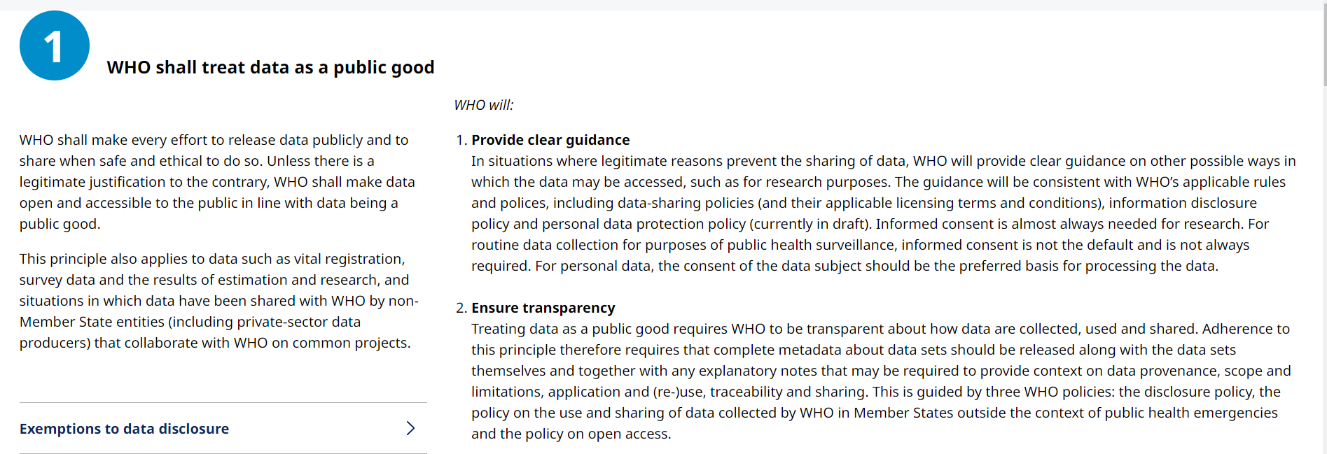
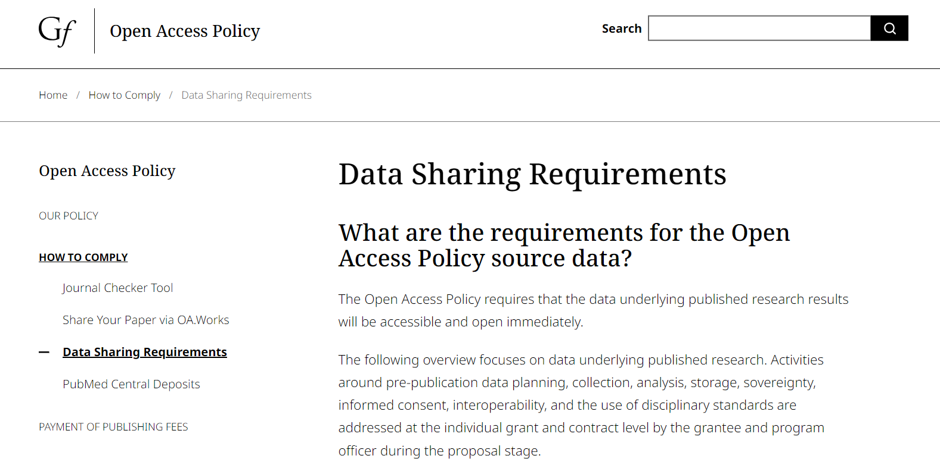
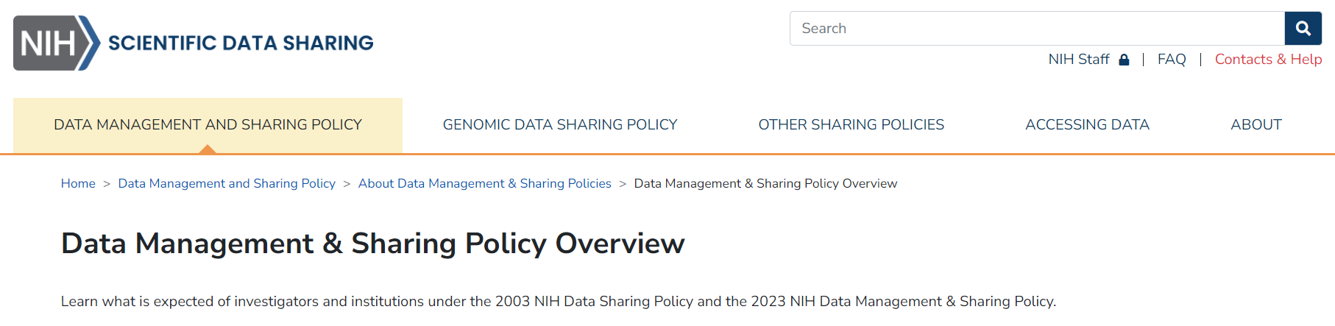

Data for public good

Slide 35
Next steps?
Informed consent waiver requirements are met
Data is not identifiable as per SA regulations – no SA-specific further ethical or legal documentation required
Will apply separately for studies conducted through Wits HREC, if required
Onus on data providers to meet country/organisational-specific ethical and legal requirements

Slide 36
Ethics in Health Research 2015 Guidelines Broad, tiered and narrow consent
i. Narrow (restrictive) consent: the donor permits use of the biological specimen for single use only; no storage of leftover specimen; and no sharing of data or specimen. This form necessitates new consent if further use is desirable.
ii. Tiered consent: the donor provides consent for the primary study and chooses whether to permit storage for future use, sample and data sharing.
iii. Broad consent: the donor permits use of the specimen for current research, for storage and possible future research purposes,35 even though the precise nature of future research may be unclear at present. The nature of the further usage should be described as fully as possible and should stipulate that further prior ethics review of the new study is necessary. Permission may be sought to re-contact the person if intended future use is outside the scope of the current consent.36

Slide 37
Ethics in Health Research 2015 Guidelines
1.1.10: Research that relies exclusively on secondary use of anonymous information or anonymous human biological materials usually need not undergo formal ethics review, provided that no identifiable information is generated. See 3.3 below for further information regarding human biological materials.
‘Anonymous data or specimen’ means data or material without any overt identifying information or link to a specific participant or donor
‘Identifier’ means information such as a name, initials, address, folder number, or biometric identifier (e.g. finger print) that can identify a particular donor
Identifiability of biological materials and data
RECs must assess the extent to which human biological materials or data could be used to identify a donor. Materials with direct identifiers can directly identify a donor. Coded materials may identify a donor if security and confidentiality measures are not adequate. Anonymised materials without any linkage to donors are unlikely to identify a donor. Materials collected without identifiers of any kind are unlikely to identify an individual donor. Genetic markers make it possible to identify groups rather than individuals. RECs must pay attention to eliminating or at least minimising risks to privacy and autonomy as a result of re-identification. RECs must also consider the implications for donor welfare of complete anonymisation: it prevents disclosure of material findings, an offer of benefits of research findings, and withdrawal of material from research use

Slide 38
Ethics in Health Research 2015 Guidelines
3.3.7 Secondary use of materials or data
Secondary use means use in research of materials or data originally collected for other purposes. Biological materials collected for diagnostic or therapeutic purposes are usually stored for future use, e.g. pathology samples. Ordinarily informed consent for removal has not anticipated such use to include research purposes. Other researchers may have banked surplus samples in a tissue bank. The importance of stored biological material as a research resource cannot be overstated. The dilemma is whether unanticipated research usage necessitates fresh informed consent and, if so, what should be done when a donor is no longer available. In the absence of broad consent to future use of material or data, including images, for research purposes, the following is recommended:
i. Use of existing or archived material collected for clinical or diagnostic purposes, including waste and surplus samples, requires expedited review. The nature of the previously obtained consent should be determined to ascertain whether subsequent usage was envisaged and whether it falls within the scope of the current proposal. If so, new consent is not required.
ii. If the scope of the current proposal is different, then new consent may be required.
iii. If samples are anonymous and the results of research would not place any individual, family or community at social, psychological, legal or economic risk of harm, then new consent is not required.
iv. If the link to identifiers exists but is not provided to the research team and the results of research will not place any individual, family or community at social, psychological, legal or economic risk of harm, then new consent is not required.
v. The person who holds the code or link should sign an explicit written agreement not to release the identifiers to the research team. This agreement should accompany the submission to the REC.
vi. If the samples can be linked to identifiers, the REC must decide on a case-by-case basis whether expedited or full review is necessary

Slide 39
SA GCP
?

Slide 40
US Human and Health Services
(f) General waiver or alteration of consent—(1) Waiver. An IRB may waive the requirement to obtain informed consent for research under paragraphs (a) through (c) of this section, provided the IRB satisfies the requirements of paragraph (f)(3) of this section. If an individual was asked to provide broad consent for the storage, maintenance, and secondary research use of identifiable private information or identifiable biospecimens in accordance with the requirements at paragraph (d) of this section, and refused to consent, an IRB cannot waive consent for the storage, maintenance, or secondary research use of the identifiable private information or identifiable biospecimens.
(3) Requirements for waiver and alteration. In order for an IRB to waive or alter consent as described in this subsection, the IRB must find and document that:
(i) The research involves no more than minimal risk to the subjects;
(ii) The research could not practicably be carried out without the requested waiver or alteration;
(iii) If the research involves using identifiable private information or identifiable biospecimens, the research could not practicably be carried out without using such information or biospecimens in an identifiable format;
(iv) The waiver or alteration will not adversely affect the rights and welfare of the subjects; and
(v) Whenever appropriate, the subjects or legally authorized representatives will be provided with additional pertinent information after participation.

Slide 41
WMA Declaration of Helsinki
Line 32. For medical research using identifable human material or data, such as research on material or data contained in biobanks or similar repositories, physicians must seek informed consent for its collection, storage and/or reuse. There may be exceptional situations where consent would be impossible or impracticable to obtain for such research. In such situations the research may be done only after consideration and approval of a research ethics committee.

Slide 42
CIOMS: International Ethical Guidelines for Biomedical Research
Guideline 4:
Use of medical records and biological specimens. Medical records and biological specimens taken in the course of clinical care may be used for research without the consent of the patients/subjects only if an ethical review committee has determined that the research poses minimal risk, that the rights or interests of the patients will not be violated, that their privacy and confidentiality or anonymity are assured, and that the research is designed to answer an important question and would be impracticable if the requirement for informed consent were to be imposed. Patients have a right to know that their records or specimens may be used for research. Refusal or reluctance of individuals to agree to participate would not be evidence of impracticability sufficient to warrant waiving informed consent. Records and specimens of individuals who have specifically rejected such uses in the past may be used only in the case of public health emergencies. (See Guideline 18 Commentary, Confidentiality between physician and patient)

Slide 43
POPIA
Section 27 General authorisation concerning special personal information
1. The prohibition on processing personal information, as referred to in section 26, does not apply if the—
d. processing is for historical, statistical or research purposes to the extent that—
the purpose serves a public interest and the processing is necessary for the purpose concerned; or
it appears to be impossible or would involve a disproportionate effort to ask for consent,4
and sufficient guarantees are provided for to ensure that the processing does not adversely affect the individual privacy of the data subject to a disproportionate extent;
Section 6 Exclusions
1. This Act does not apply to the processing of personal information—
b) that has been de-identified to the extent that it cannot be re-identified again;
Section 15 Further processing to be compatible with purpose of collection
3. The further processing of personal information is not incompatible with the purpose of collection if—
e) the information is used for historical, statistical or research purposes and the responsible party ensures that the further processing is carried out solely for such purposes and will not be published in an identifiable form; or
Section 18: Notification to data subject when collecting personal information
4. It is not necessary for a responsible party to comply with subsection (1) if—
f) the information will—
i. not be used in a form in which the data subject may be identified; or
ii. be used for historical, statistical or research purposes.
Section 14 Retention and restriction of records
2) Records of personal information may be retained for periods in excess of those contemplated in subsection (1) for historical, statistical or research purposes if the responsible party has established appropriate safeguards against the records being used for any other purposes.

Slide 44
POPIA definitions
‘‘de-identify’’, in relation to personal information of a data subject, means to delete any information that— (a) identifies the data subject; (b) can be used or manipulated by a reasonably foreseeable method to identify the data subject; or (c) can be linked by a reasonably foreseeable method to other information that identifies the data subject,
‘‘re-identify’’, in relation to personal information of a data subject, means to resurrect any information that has been de-identified, that— (a) identifies the data subject; (b) can be used or manipulated by a reasonably foreseeable method to identify the data subject; or (c) can be linked by a reasonably foreseeable method to other information that identifies the data subject, and ‘‘re-identified’’ has a corresponding meaning;

Slide 45
POPIA definitions
‘‘personal information’’ means information relating to an identifiable, living, natural person, and where it is applicable, an identifiable, existing juristic person, including, but not limited to— (a) information relating to the race, gender, sex, pregnancy, marital status, national, ethnic or social origin, colour, sexual orientation, age, physical or mental health, well-being, disability, religion, conscience, belief, culture, language and birth of the person; (b) information relating to the education or the medical, financial, criminal or employment history of the person; (c) any identifying number, symbol, e-mail address, physical address, telephone number, location information, online identifier or other particular assignment to the person; (d) the biometric information of the person; (e) the personal opinions, views or preferences of the person; (f) correspondence sent by the person that is implicitly or explicitly of a private or confidential nature or further correspondence that would reveal the contents of the original correspondence; (g) the views or opinions of another individual about the person; and (h) the name of the person if it appears with other personal information relating to the person or if the disclosure of the name itself would reveal information about the person; ‘‘prescribed’’ means prescribed by regulation or by a code of conduct; ‘‘private body’’ means— (a) a natural person who carries or has carried on any trade, business or profession, but only in such capacity; (b) a partnership which carries or has carried on any trade, business or profession; or (c) any former or existing juristic person, but excludes a public body;

Slide 46
European GDPR
The data subjects are identifiable if they can be directly or indirectly identified, especially by reference to an identifier such as a name, an identification number, location data, an online identifier or one of several special characteristics, which expresses the physical, physiological, genetic, mental, commercial, cultural or social identity of these natural persons. In practice, these also include all data which are or can be assigned to a person in any kind of way. For example, the telephone, credit card or personnel number of a person, account data, number plate, appearance, customer number or address are all personal data.

Slide 47
Types of Identifiers
Two types of identifiers may collected during research, which would need protection from being revealed if that data is shared (either on purpose or accidently!)
Direct identifiers are the types of information that directly links variables to subjects, and to people or institutions associated with them.
HIPAA lists 18 typical direct identifiers for PHI as part of the standards for patient protection used by US. Health and Human Services. See the tab for a summary list.
Indirect identifiers, also called inferential identifiers or Quasi-identifiers, can be more challenging to locate and protect.
These are characteristics that may not be unique in the whole population, but are unique to your particular sample and can be correlated with other information to create direct identifiers and re-identify one or more participants in a study. See the tab for examples.

Slide 48
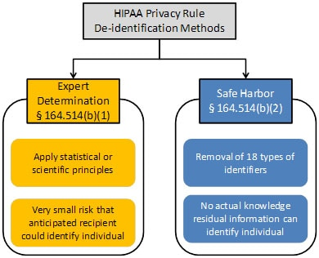
HHS: Health Insurance Portability and Accountability Act (HIPAA) Privacy Rule
The De-identification Standard
Section 164.514(a) of the HIPAA Privacy Rule provides the standard for de-identification of protected health information. Under this standard, health information is not individually identifiable if it does not identify an individual and if the covered entity has no reasonable basis to believe it can be used to identify an individual.
§ 164.514 Other requirements relating to uses and disclosures of protected health information. (a) Standard: de-identification of protected health information. Health information that does not identify an individual and with respect to which there is no reasonable basis to believe that the information can be used to identify an individual is not individually identifiable health information.
Sections 164.514(b) and(c) of the Privacy Rule contain the implementation specifications that a covered entity must follow to meet the de-identification standard. As summarized in Figure 1, the Privacy Rule provides two methods by which health information can be designated as de-identified.
https://www.hhs.gov/hipaa/for-professionals/privacy/special-topics/de-identification/index.html#standard

Slide 49
HIPAA Identifiable Data
(2)(i) The following identifiers of the individual or of relatives, employers, or household members of the individual, are removed:
(A) Names
(B) All geographic subdivisions smaller than a state, including street address, city, county, precinct, ZIP code, and their equivalent geocodes, except for the initial three digits of the ZIP code if, according to the current publicly available data from the Bureau of the Census: (1) The geographic unit formed by combining all ZIP codes with the same three initial digits contains more than 20,000 people; and (2) The initial three digits of a ZIP code for all such geographic units containing 20,000 or fewer people is changed to 000
(C) All elements of dates (except year) for dates that are directly related to an individual, including birth date, admission date, discharge date, death date, and all ages over 89 and all elements of dates (including year) indicative of such age, except that such ages and elements may be aggregated into a single category of age 90 or older
(D) Telephone numbers
(L) Vehicle identifiers and serial numbers, including license plate numbers
(E) Fax numbers
(M) Device identifiers and serial numbers
(F) Email addresses
(N) Web Universal Resource Locators (URLs)
(G) Social security numbers
(O) Internet Protocol (IP) addresses
(H) Medical record numbers
(P) Biometric identifiers, including finger and voice prints
(I) Health plan beneficiary numbers
(Q) Full-face photographs and any comparable images
(J) Account numbers
(R) Any other unique identifying number, characteristic, or code, except as permitted by paragraph (c) of this section [Paragraph (c) is presented below in the section “Re-identification”]; and
(K) Certificate/license numbers

